Slide 2
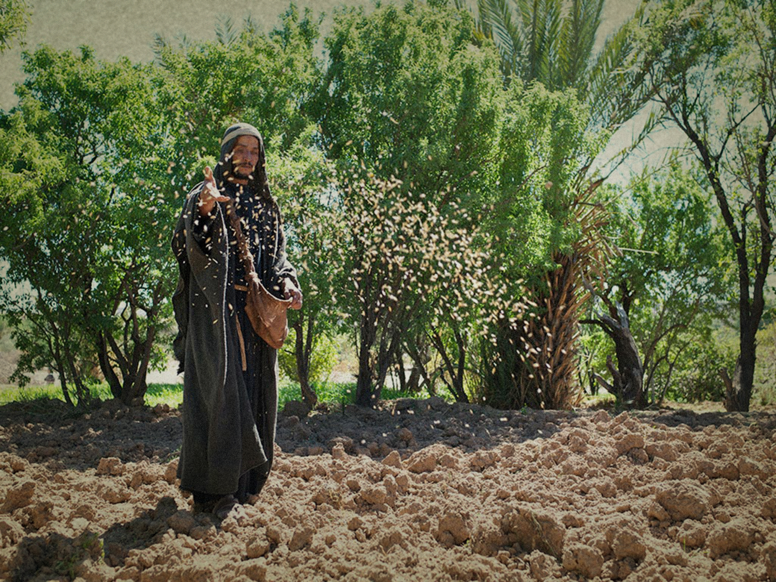
Mark 4:2-9

Slide 3
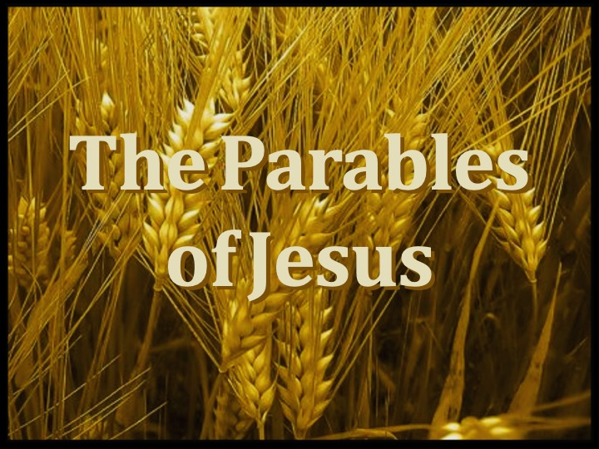

Slide 4

“a placing of two or more objects together, usually for the purpose of a comparison.” ISBE
“a comparison of earthly with heavenly things, "an earthly story with a heavenly meaning,“ Easton Bible Dictionary
In Parables a KNOWN thing is used to compare with and explain something UNKNOWN

Slide 5
Mark 4:2-9
Matthew 13:3-9,18-23
Luke 8:4-15
The Parable Of The Sower

Slide 6
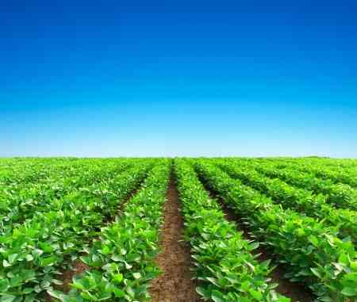
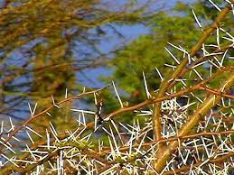
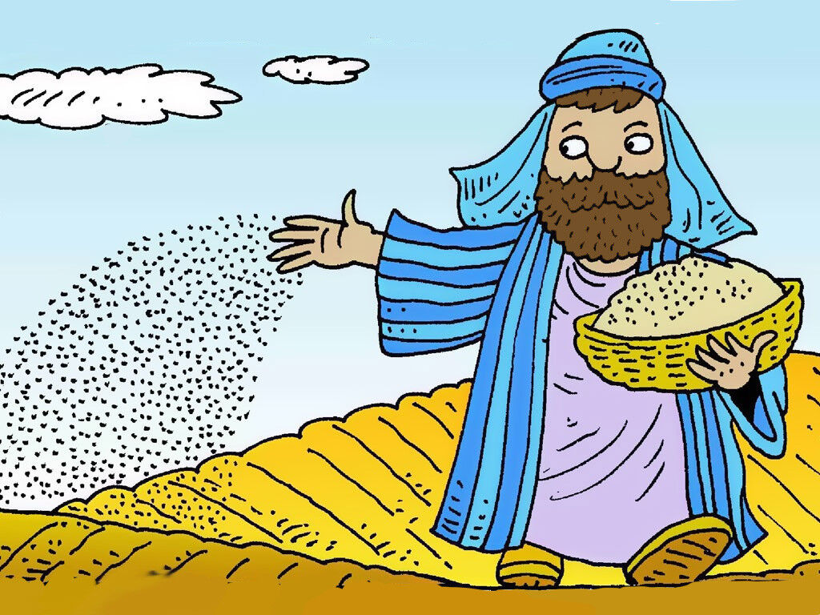
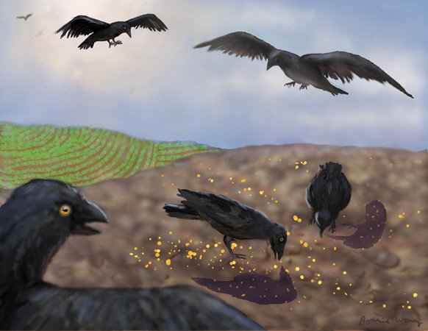

The Parable Of The Sower (or Soils)
Sower Spreads The Seed
  Seed on the Wayside
  Seed on Rocky Ground
  Seed Among the Thorns
  Seed on Good Soil

Slide 7
The Parable Of The Sower (or Soils)
Explanation Of The Parable
  Seed Is The Word – Deuteronomy 22:9
  Wayside Soil – too hard to respond to the Message- Acts 17:32; 22:21-23; John 12:48
  Rocky Ground – receive with joy, fall away – 2 Timothy 4:10; Luke 14:27-33; 1 Corinthians 15:58
  Among The Thorns – never divorce themselves from the world – 1 John 2:15; 1 Timothy 6:17; Philippians 4:11-13; Hebrews 13:5
  Good Soil- hears, accepts the word and bears fruit – John 15:2,5,8

Slide 8
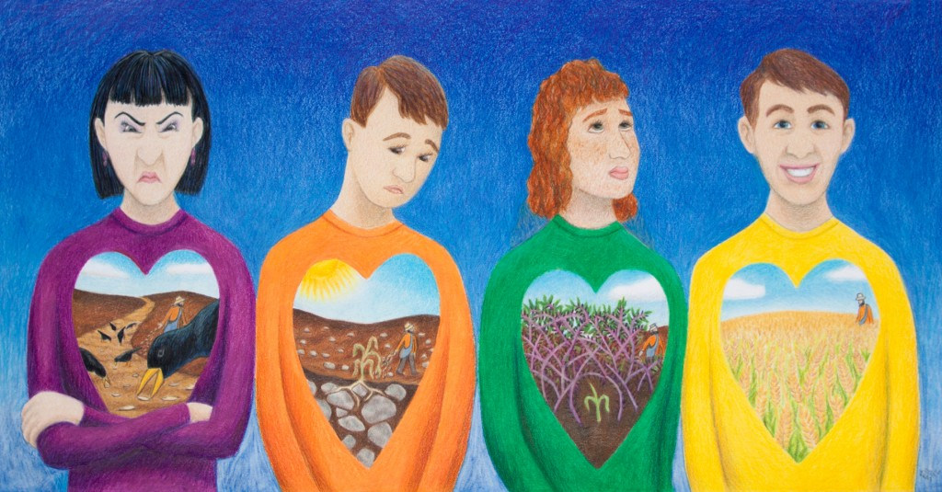
Which Type Of Soil Are WE?

